Slide 1
Mac AI Radiology-and-AI Project Update
Feb 10 2021

Slide 2
Current Status
Overview
Workflow
Research
Demonstration

Slide 3
Overview
Building workflow and tools for training with Neuroimaging data
Performing BraTS segmentation task
Researching best methods for performing tasks
Reviewing existing literature
Models used, augmentation and normalization methods

Slide 4
Workflow
Also using Git for version control, training on Google Colab platform
Convert Dicom to Nifti: dcm2niix
Coregistration: SPM (Matlab)
Skull Stripping: ROBEX
Dataset Storage: Webdatasets
Normalization: Z-score, Nyul
Collation
Augmentation: Power Law Transformation, (Elastic Deformation)
Apply normalization
Training: Pytorch/Pytorch Lightning, UNet3D
Visualization

Slide 5
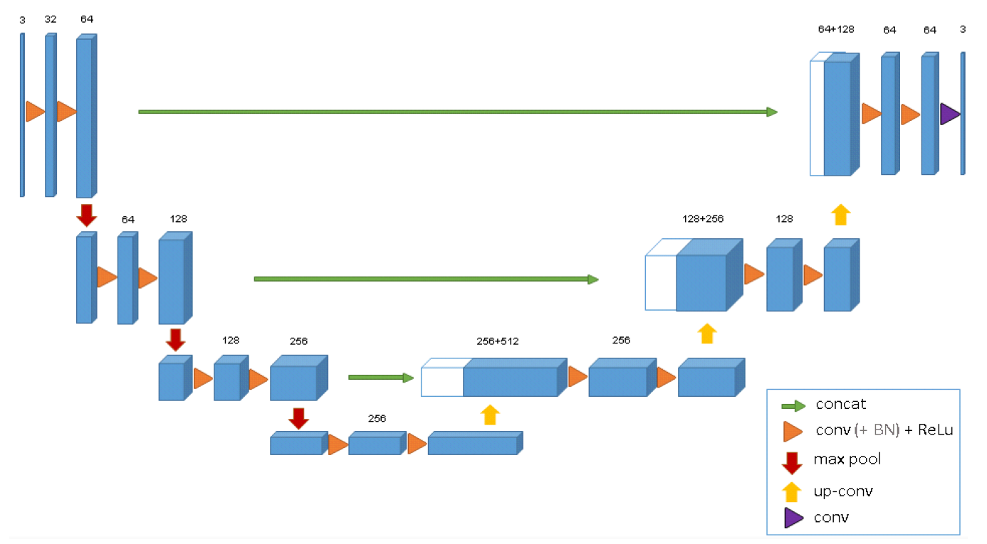
Workflow Continued
Webdatasets allows for memory efficient data storage and loading
Pytorch Lightning provides interface for more easily performing deep learning tasks
UNet3D is widely used architecture
Synthesis & Analysis path
Won BRaTS 2020
Radiology_and_AI package
Methods for collation, augmentation, training, data visualization

Slide 6
Research
Have done reviews of some current literature to inform us
Write-ups/summaries on following topics:
UNet and other Models for segmentation task
Other implementation of ML for characterizing tumours
Most beneficial data augmentations to perform
Elastic Deformation
Pseudo vs True progression paper sent by Fateme
Notes:
Demonstrate training
Show performance of segmentation model
Show visualizations of segmentations

Slide 7
Demonstration
Notes:
Demonstrate training
Show performance of segmentation model
Show visualizations of segmentations

Slide 8
Other points to discuss
SMets Dataset
Normalization and Manual Segmentation
Next Steps

Slide 9
SMets Dataset
Organized by patient and examinations
Not all examinations have same sequence types used
Can only use those sharing sequence types
64 different combinations of sequence names
152 experiments coregistered and uploaded to PHRI
Under jan_18_coregistered folder
Docs showing where each entry comes from in SMets
Each had one of the below selections of sequences performed

Slide 10
Normalization and Manual Segmentation
Need to establish when to apply normalization
Manual segmentation before or after image normalization
We have found segmentation before normalization is standard

Slide 11
Next Steps/Future Plans
Can take project in whatever direction is most useful
Other tasks
Progression vs Pseudoprogression
Tools/Tutorials for you and other lab members to use

